Slide 1
Composites
Dr. Ranjit Kumar
Department of Chemical Engineering
Email: ranjit.kumar@snu.edu.in

Slide 2
Composites
Combine materials with the objective of getting a more desirable combination of properties
Ex: get flexibility & weight of a polymer plus the strength of a ceramic
Principle of combined action
Mixture gives “averaged” properties
Notes:
Don’t always get what you want
Ex: combine ferret (pet) + mink (fur)
Desire a mink with good disposition but got a nasty ferret

Slide 3
Matrix and Dispersed Phase
Schematic representations of the various geometrical and spatial characteristics of particles of the dispersed phase that may influence the properties of composites: (a) concentration, (b) size, (c) shape, (d) distribution, and (e) orientation.

Slide 4
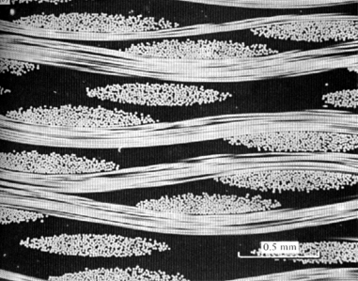
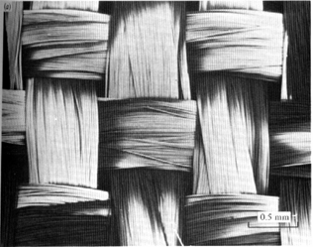
Terminology/Classification
• Composites:
-- Multiphase material w/significant
proportions of each phase.
woven
fibers
• Matrix:
-- The continuous phase
-- Purpose is to:
- transfer stress to other phases
- protect phases from environment
-- Classification: MMC, CMC, PMC
0.5
mm
cross
section
view
metal
ceramic
polymer
• Dispersed phase:
-- Purpose: enhance matrix properties.
-- Classification: Particle, fiber, structural
0.5
mm

Slide 5
Composite

Slide 6
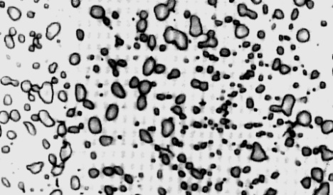
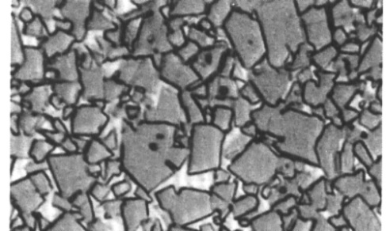
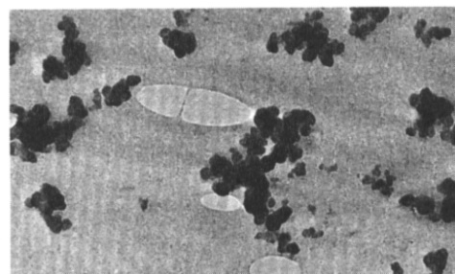
Composite Survey: Particle
Particle-reinforced
Fiber-reinforced
Structural
• Examples:
- Spheroidite
matrix:
particles:
steel
ferrite (α)
cementite
(ductile)
(
Fe
3
C
)
(brittle)
60 μm
- WC/Co
matrix:
particles:
cemented
cobalt
WC
carbide
(ductile)
(brittle,
V
m
:
hard)
10-15 vol%!
600 μm
- Automobile
matrix:
particles:
tires
rubber
C
(compliant)
(stiffer)
0.75 μm

Slide 7
Composite Survey: Fiber
Particle-reinforced
Fiber-reinforced
Structural
Fiber Materials
Whiskers - Thin single crystals - large length to diameter ratio
graphite, SiN, SiC
high crystal perfection – extremely strong, strongest known
very expensive
Fibers
polycrystalline or amorphous
generally polymers or ceramics
Ex: Al₂O₃ , Aramid, E-glass, Boron, UHMWPE
Wires
Metal – steel, Mo, W

Slide 8
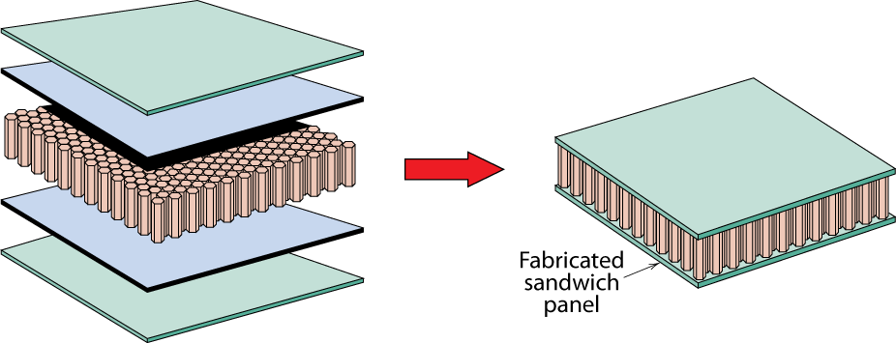
Composite Survey: Structural
Particle-reinforced
Fiber-reinforced
Structural
• Stacked and bonded fiber-reinforced sheets
-- stacking sequence: e.g., 0º/90º
-- benefit: balanced, in-plane stiffness
• Sandwich panels
-- low density, honeycomb core
-- benefit: small weight, large bending stiffness
face sheet
adhesive layer
honeycomb

